Slide 1
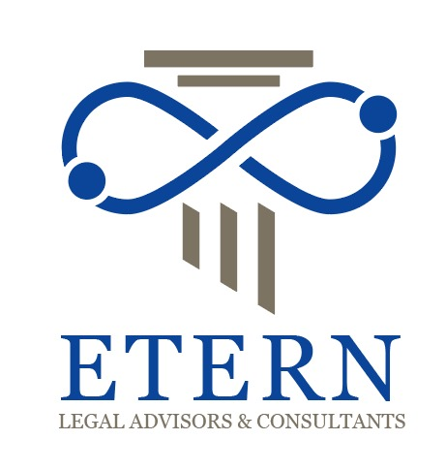
Expertise Trustworthy Empathy Resilience Nimble
FIRM PROFILE

Slide 2
ABOUT US
M/s. ETERN Legal Advisors & Consultants ("ETERN") has been established with five pillars in mind; Expertise, Trustworthy, Empathy, Resilience and Nimble and driven to provide effective, efficient and compliant legal services to its client at reasonable costs.
ETERN is set up by a team of legal and corporate professionals with experience spanning more than 25 (Twenty Five) years having accomplished professional services delivering in employments with listed & unlisted entities and a corporate & legal advisory with a domestic law firms.
The team of ETERN have practice encompasses advising clients in the area of Mergers & Acquisitions, Joint Ventures, Capital Markets (both In Equity and Debt), Banking & Finance, Private Equity Investments, Foreign Collaborations & Technology Transfers, Legal Compliance Due Diligences/Audits, Real Estate, Mortgage Business, etc.
ETERN has its offices at New Delhi, Mumbai and also have presence in Hyderabad, Chennai, Bangalore, Kolkata, Jaipur and Ahmedabad. The team members of ETERN are driven by their common intention to bring their experience, exposure and expertise for providing personalized professional services and representation to its clients while maintaining highest benchmarks of excellence and integrity. The lawyers of ETERN are engaged in practicing laws on regulatory & transactional side, real estate and litigation in various courts and specialized tribunals depending upon issues of its clients.
ETERN has strategic tie-ups and formal affiliation with law firms in India and also abroad. The interdisciplinary team of lawyers provides legal representation in the various areas of law.

Slide 3
PRACTICE AREAS
Corporate & Commercial Law;
M & A and Capital Markets;
Banking & Finance;
Regulatory Compliances;
Insurance laws and regulations;
Real Estate;
Litigation, Restructuring, Insolvency & Dispute Resolution;
Employment & Labour Law;
Intellectual Property.

Slide 4

I. CORPORATE & COMMERCIAL LAW

Slide 5
ETERN is engaged in incorporation and structuring of Companies, formation of other legal entities, advising on private equity placements, corporate matters, management agreements, mergers & acquisitions, amalgamations/ merger, de-mergers, bought out deals, public and rights issues of shares & securities, commercial agreements, winding-up and insolvency, environmental law, tax laws and insurance laws and regulations.
ETERN represents its clients before various regulatory authorities such as the Reserve Bank of India, Department of Company Affairs, Directorate General of Foreign Trade and other regulatory bodies.
ETERN is also engaged by its clients for Legal opinions on matters falling under the Companies Act, Securities Laws and Regulations, various Commercial laws, Foreign Exchange Management laws, Cyber Laws.
ETERN specializes in framing entry and exit strategies by overseas investors in various permitted sectors and all related transactional documentation.

Slide 6

II. MERGER & ACQUISITION AND CAPITAL MARKETS

Slide 7
ETERN is actively engaged in providing legal services and assistance on issues relating to capital market activities and has successfully handled various assignments in relation thereto by its team members during their respective tenure in the earlier organization.
incorporation and registration of foreign institutional investors;
incorporation and registration of venture capital fund companies;
providing legal advice and assistance on issues arising out of SEBI (SAST) Regulations, 2011 for takeover of listed companies;
providing legal advice and assistance on issues related incorporation of NBFCs with RBI;
providing legal advice and assistance on routine issues arising in relation to compliances & returns applicable to NBFC, basis its nature of categories of NBFC, under applicable provisions of Prudential Regulation of RBI Master Directions, Circulars, notices, if any, issued by RBI from time to time;
SEBI (Substantial Acquisition of Shares and Takeover) Regulations, 2011 for takeover of listed companies;
providing legal advice and assistance on resolution of queries raised by SEBI and stock exchanges;
advise on matters in relation to infusion of equity by foreign investors in listed companies;
legal due diligence of companies coming out with restructuring and such other activity;
Compliance related issues of listed and unlisted entities, basis of regulator(s) of sector specific activities of such entities; and
vetting of offering circular, information memorandum, etc. of overseas companies with an intent to acquire business in India.
Services in relation to IPO
Apart from above, ETERN has a team of professionals that caters to requirements of clients coming out with IPOs of equity as well debt securities in terms of SEBI (ICDR) Regulations, 2018, SEBI (LODR) Regulations, 2018, SEBI (Issue and Listing of Non-Convertible Securities) Regulations 2021, the Companies Act, 2013 and Sector specific laws.

Slide 8
Mergers and Acquisitions
Handled successfully the assignments received from abroad (U.K., U.S.A. and Italy) in connection with the Mergers & Acquisitions in India, together with leading law firms in India and abroad.
Due Diligence
On the target companies with whom the exercise of Mergers & Acquisitions was initiated.
Drafting of the contractual documentation, including Escrow Agreements and any other agreement as required in connection with such activities.

Slide 9

III. BANKING & FINANCE

Slide 10
ETERN specializes in drafting and reviewing foreign currency syndicated loan documentation, financial guarantees, standby letters of credit, obtaining regulatory approvals from the Reserve Bank of India and providing legal opinions on escrow mechanisms and perfection of security interest of lenders and enforcement of securities, in case of default by its borrower.
Corporate Banking:
ETERN specializes in drafting and reviewing related security documents pertaining to structured finance deals, derivatives, assignments, factoring, asset reconstruction, securitization, carrying out portfolio audit and providing legal opinions on connected legal issues.
It provides professional advises:
On project finance related to sector specific i.e. infrastructure finance, power sector finance and other sector specific finance.
Structuring and drafting of documentation for a structure finance transaction in respect of term loan facility and Standby Letter of Credit Facility towards equity infusion.
On a derivative transaction in respect of Syndicated loan in the form of external commercial borrowings.
Drafting of documentation with regard to aircraft financing transaction undertaken.
On digital financing and its related issues.

Slide 11
International Trade Finance:
ETERN specializes in providing legal opinions on matters falling under Uniform Customs and Practices for Documentary Credits, International Standby Practices, International Commercial Code, Uniform Rules for Collection, Negotiable Instruments Act, 1882, Indian Contract Act, 1872 and drafting and reviewing of documents pertaining to Trans border trade finance transactions.
Retail/Personal Banking:
ETERN is engaged in drafting and reviewing of documentation pertaining to housing, auto and personal loans payment products, (such as debit cards, credit cards, smart cards, etc.) structured retail banking facilities provided to corporates for cash management facilities, salary accounts, doorstep banking facilities. ETERN advises banks on several legal issues pertaining to opening and operation of bank accounts by different entities.
Investment Banking:
ETERN advises investment bankers on issues arising out of the foreign investment policy of the Government of India, regulatory issues arising out of exchange management and the foreign trade policy of the Government of India, joint ventures and foreign institutional investors to big corporate groups of international repute with regard to making of foreign investment in the fields of insurance, manufacturing, whole sale trading with specialized after sale services, information technology, hotels and resorts.
ETERN has expertise in providing complete solution for establishment of business by the foreign investors, identifying competent and financially sound partners, and providing necessary legal support for obtaining regulatory permission from various regulatory authorities and setting up of business in India

Slide 12

IV. REGULATORY COMPLIANCES

Slide 13
ETERN specializes in sector specific regulatory compliance matters falling under:
Corporate laws;
Capital Market laws;
Foreign trade laws;
Foreign Exchange Management laws and regulations;
Foreign Direct Investment Policy of Government of India;
NBFC and HFC related compliances of Regulation, Direction, Circulars of RBI/NHB;
HFC related compliances of Prudential Regulation of RBI Master Direction;
Real Estate (Regulation and Development) Act, 2016 and Rules formulated and notified by States: and
Employment related compliance as per applicable provisions laws basis sector of entity.
Provides compliance advisory related to data protection and its allied issues.

Slide 14

V. INSURANCE LAWS & REGULATIONS

Slide 15
ETERN regularly provides opinions in relation to the matters pertaining to Insurance Laws and Regulations. ETERN is actively involved in providing advice on various matters falling under the Insurance Act, 1938, Insurance Regulatory and Development Authority Act, 1999 and the Regulations framed there under.
ETERN renders legal support to companies engaged in the insurance sector for various activities undertaken by them. The support services rendered by ETERN inter-alia comprise of:
Legal support for entering the Insurance Sector- JVA, Funding, Liaison with the Regulator for licensing.
Structuring and drafting of distribution agreement/ tie-ups for Bank assurance Partnerships, Brokers and Agents.
Product documentation (Drafting of policy contract of insurance plans such as unit linked, individual, group, pension) to helps preempt/ prevent litigation.
Legal support in devising the compliance structure for the Company.
Legal support for negotiation of arrangements with re-insurers.
Legal support in establishing the branches- Due diligence for acquisition of immoveable properties, lease agreements and local compliances across the country.
Litigation support against claims and disputes across the country.
Service Provider tie ups – IT, Marketing, outsourcing agreements.

Slide 16

VI. REAL ESTATE

Slide 17
ETERN has considerable experience in providing comprehensive and innovative advice to investors and developers on acquisition, development, and funding and divestment activities in real estate including regulatory compliance issues related to RERA as per relevant rules of related States of India.
It advices real estate transactions including contractual document relating to collaboration, development, sale, purchase and transfer of built-up residential flats and commercial spaces, malls, development of integrated townships. Etern provides professional services of due diligence exercise pertaining to land ownership records and provide opinion on ownership title, marketability and non-encumbrance status of properties to Fis and corporate bodies.
It represents institutional investors, lenders, venture capital funds and companies in connection with financing and acquisition of large scale built up commercial & residential projects, integrated townships and theme amusement parks and recreational complexes.
It advises on incorporation of Real Estate funds outside India with company handholding on the Real Estate opportunities existing in India, and the manner in which the investments in the Real Estate sector can be made.
It provides services of drafting of Joint Venture Agreements, Shareholding Agreements and advice for project in India can be successfully completed by making investments in the project or SPV, Etc.
It also advises on Real Estate matters in the nature of residential flats, commercial malls, hospitality industry, hospitals, IT zones, Special Economic Zones (SEZs), including the regulatory issues.
It carries out due diligence and assistance in the matter of infrastructure related projects and its allied activities.

Slide 18

VII. LITIGATION, RESTRUCTURING, INSOLVENCY & DISPUTE RESOLUTION

Slide 19
ETERN’s litigation team provides a comprehensive range of services in litigation matters both in Civil and Criminal matters, which inter-alia include, litigation involving commercial laws, corporate laws, banking & finance, shipping claims, properties, building & engineering, economic offences, trade marks & copyright infringements, offences under the Negotiable Instruments Act, Insolvency & Bankruptcy practice.
ETERN’s litigation group advises and acts in all types of commercial and corporate cases, from simple disputes that may only require pragmatic negotiation to major cases. The litigation group also specializes in domestic as well as international commercial arbitration and has its presence in Supreme Court of India, High Courts in India, tribunals, district courts and other trial courts.
The experienced team of specialized and dedicated lawyers collectively provides effective and result oriented legal representation to the clients in all courts and quasi-judicial tribunals having original and appellate jurisdictions.
The scope of services includes drafting & institution of suits, petitions, claims, memorandum of appeals, special leave petitions, write petitions, replies, counter affidavits in opposition to claims and petitions, leading evidence and conducting the litigation till its finality.

Slide 20

VIII. EMPLOYMENT & LABOUR LAW

Slide 21
ETERN specializes in providing legal opinions and representation to its clients on employee related laws and regulations.
ETERN specializes in drafting and reviewing of various contracts that have employee related implications. The expertise includes Laws relating to Service Contracts, Employees State Insurance, Provident Fund, and Workmen’s Compensation, Conciliation and Industrial Disputes, Payment of Wages, Bonus, Gratuity and Factory Laws.
In particular, ETERN provides its professional services for developing manual for compliance under various labour legislations applicable to factories and commercial establishments, basis of sector in which such entities operates.

Slide 22

IX. INTELLECTUAL PROPERTY

Slide 23
ETERN has expertise in drafting of technology transfer agreements, intellectual property licensing agreements, outsourcing agreements.
ETERN also advises on piracy prevention techniques.
Team of ETERN is specialize in domain name dispute resolution, registration of trade mark, copy right, patent, documentation on Internet Service Providers (ISP’s) and drafting of other related agreement.

Slide 24
PROFILES OF PARTNERS

Slide 25
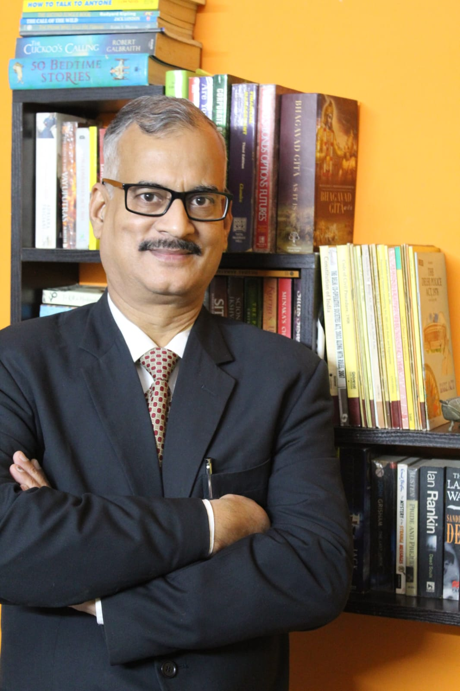
Saroj Kumar Pandey, Managing Partner
Areas of Practice: Saroj Kr. Pandey is a legal and corporate professional with an experience spanning more than 28 years, an accomplished professional delivering over 14 years of career in employments with listed & unlisted entities and corporate & legal advisory with a domestic law firm for about 14 years. Mr. Pandey was employed with BLB Limited, one of the first corporate listed entity in India, InterGloble Enterprises Limited, parent entity of IndiGo Airlines and partner of SNG & Partners, a law firm.
He has a vast breadth of experience in corporate and transactional matters. His practice encompasses advising clients in the area of Mergers & Acquisitions, Joint Ventures, Capital Markets (both in equity and debt), Banking & Finance, Private Equity Investments, Foreign Collaborations & Technology Transfers, Securities, Complex legal due diligences/audits including various commercial transactions.
Education: M. Com. (Delhi University), LL.B. (Campus Law Centre, Delhi University), Professional course from the Institute of Company Secretaries of India (‘ICSI’), New Delhi.
Professional Memberships: Member of Bar Council of Delhi. Licensed to practice law throughout India, Delhi High Court Bar Association, Fellow Member of ICSI.
Professional Experience: 28 years

Slide 26
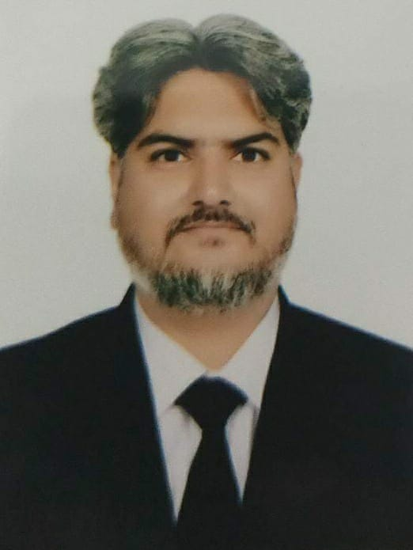
Gaurav Kapoor (Partner)
Areas of Practice: Mr. Gaurav Kapoor is an established lawyer with an extensive knowledge and experience in G.S.T., Notices and Appeals, G.S.T. Assessments, Tax Auditing, Accounting, issuance of Digital Certificates and All Types of G.S.T and Income Tax Consultancy. He has earned his LL.B in 2005 and has also been enrolled as an Advocate with the Delhi High Bar Council since then. He is a seasoned lawyer with 18 years of experience.
Education: B.A. LL B
Professional Memberships: Member of Bar Council of Delhi. Licensed to practice law throughout India.
Professional Experience: 18 years

Slide 27
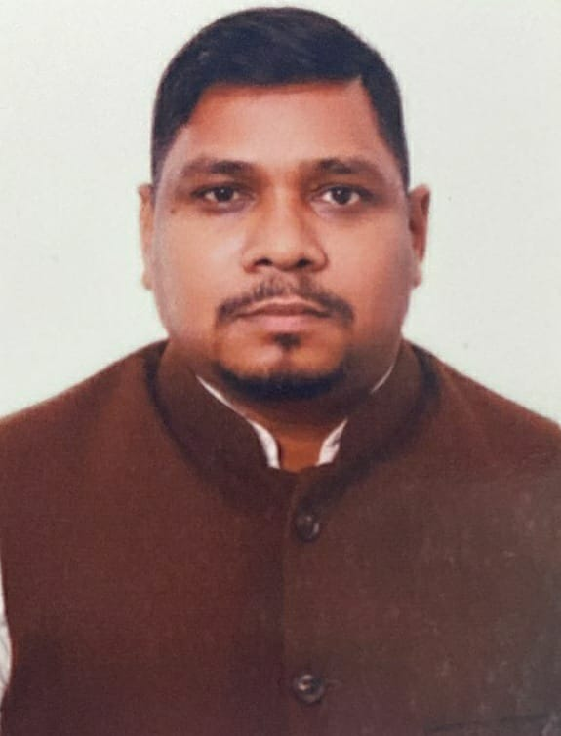
Mr. Vikram K Saw (Partner)
Areas of Practice: He is an established banking and finance lawyer with an extensive knowledge and experience in mortgage-backed transactions, their execution etc. His expertise lies in Property Law, Revenue Laws, Recovery Laws, and Due Diligence Investigation on Title for real estate companies and for various financial institution across the country. He also handles score of cases in the field of commercial civil, arbitration and DRT cases and helps the Dispute Resolution team in drafting various application, pleadings, written submission, writ etc.
Previously, Mr. Saw was associated with Khaitain & Khaitan and he also worked with Hero Group, Kotak Mahindra Bank, Dewan Hosing, Religare group as in house legal counsel and uses his experience in unique approach to set up and manage the legal structure, debt recovery system and to provide opinion on legal issues.
Education: LL.B from University of Delhi
Professional Memberships: Member of Bar Council of Delhi. Licensed to practice law throughout India
Professional Experience: 18 years

Slide 28
CONTACT US
Delhi Office
# 909, 9th Floor, Prakash Deep, 7 Tolstoy Marg, New Delhi 110001.
# 4E/9, 2nd floor, Jhandewalan Extension, New Delhi: 110055.
E-mail:
# saroj.pandey@etern.co.in
vikram.saw@etern.co.in
eternlegal@gmail.com
+91-9811432283
+91-9899638482

